Slide 1
Soluble Vitamin (Vitamin D)
Name
Institution of Affiliation
Date

Slide 2
Presentation Overview
Vitamins: Their Definition and general functions.
Types of Vitamins: Fat soluble and Water soluble
Fat soluble vitamins: Vitamin D
Sources
Functions
Deficiency
At risk
Summary
References

Slide 3
Vitamins: Their Definition and general functions
Vitamins are a group of substances required for normal cell function, growth, and development.
They are required by the body in minute quantities.
Lack of sufficient vitamins may increase risk of developing health issues.
Vitamins are organic compounds i.e. they contain carbon
There are 13 essential vitamins carrying out variety of functions in the body including shoring bones, healing wounds, bolstering the immune system, converting food to energy, and also repairing damaged cells among other functions (Aslam et al, 2017).
Different vitamins play different roles in the body an a person requires different amount of each vitamin to satay healthy.
Notes:
Vitamins are a group of substances required for normal cell function, growth, and development. There are 13 essential vitamins carrying out variety of functions in the body including shoring bones, healing wounds, bolstering the immune system, converting food to energy, and also repairing damaged cells among other functions.

Slide 4
Types of Vitamins: Fat soluble and Water soluble
There are two types of vitamins: fat soluble and water soluble.
The fat soluble vitamins tend to stay in the body longer since they are stored in the fatty tissues and drawn when needed.
Fat soluble vitamins can stay in the body for up to six months.
Dietary fats help the body absorb fat soluble vitamins through the intestinal track.
Water soluble vitamins are absorbed from the bloodstream when consumed, those needed are absorbed while the excess is excreted.
Vitamins A, D, E, and K are examples of fat soluble vitamins. This presentation will focus on vitamin D.
Notes:
There are two types of vitamins: fat soluble and water soluble. The fat soluble vitamins tend to stay in the body longer since they are stored in the fatty tissues and drawn when needed. They can stay for a period of up to six months. Water soluble vitamins are absorbed from the bloodstream when consumed, those needed are absorbed while the excess is excreted. Vitamins A, D, E, and K are examples of fat soluble vitamins. This presentation will focus on vitamin D.

Slide 5
Fat soluble vitamins: Vitamin D
Vitamin D is not a vitamin per ser but a precursor of hormone.
Many vitamins cannot be produced by the body and one have to consume them, however vitamin D can be produced by the body.
The human body produces vitamin D when exposed to the sun.
Vitamin D is a group of compounds collectively known as calciferol.
Calciferol is absorbed in the bloodstream and converted to calcitriol (DeLuca, 2012).
Two types of Vitamin D occur naturally.
They are:
  vitamin D-3 found in animal fats, and
  vitamin D-2 found in plants like mushroom.
Notes:
Vitamin D is a group of compounds collectively known as calciferol. Calciferol is absorbed in the bloodstream and converted to calcitriol. Two types of Vitamin D occur naturally, they are; vitamin D-3 found in animal fats, and vitamin D-2 found in plants like mushroom.

Slide 6
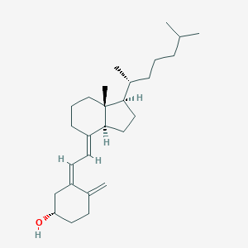
Notes:
This is the chemical structure of vitamin D.

Slide 7
Vitamin D: Sources
Getting sufficient sunlight is the best way to help the body produce enough vitamin D.
Other dietary sources include oily fish and fish oils, fortified dairy products, beef liver, and eggs.
Fatty fish such as salmon, mackerel, and tuna are the best sources of Vitamin D as they contain it in plenty.
Supplements can also be taken as sources for this vitamin.
Notes:
Vitamin D can be obtained from the sun or other dietary sources such as oily fish and fish oils, fortified dairy products, beef liver, and eggs

Slide 8
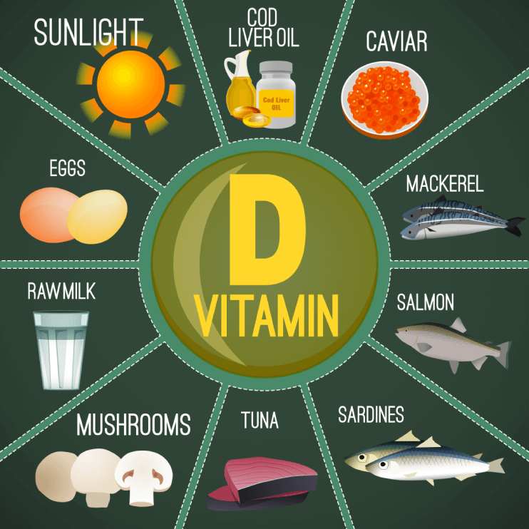
Vitamin D: Sources
Notes:
Best sources of vitamin D.

Slide 9
Vitamin D: Functions
Vitamin D has multiple roles in the body. It assists in:
  promoting healthy bones and teeth – this is because vitamin D play an important role in regulation of calcium and maintenance of phosphorous levels in the blood, minerals that are necessary for maintaining health bones.
  supporting immune, brain, and nervous system health
  regulating insulin levels and supporting diabetes management
  supporting lung function and cardiovascular health
  influencing the expression of genes involved in cancer development
Notes:
Vitamin D has multiple roles in the body. It assists in: promoting healthy bones and teeth, supporting immune, brain, and nervous system health, regulating insulin levels and supporting diabetes management, supporting lung function and cardiovascular health, and influencing the expression of genes involved in cancer development.

Slide 10
Vitamin D: Deficiency
The main effects of lack of sufficient Vitamin D are:
  Osteoporosis which is the loss of bone mass
  Osteomalacia – a condition which makes bone softs
  Rickets – a condition which affects kids because lack of vitamin D makes it difficult for the body to absorb calcium and phosphorous in level required for proper development of bones.
  Deficiency of vitamin D can also cause increased risk of infections and autoimmune diseases.
Notes:
The main effects of lack of sufficient Vitamin D are: Osteoporosis which is the loss of bone mass, Osteomalacia – a condition which makes bone softs
Rickets – a condition which affects kids because lack of vitamin D makes it difficult for the body to absorb calcium and phosphorous in level required for proper development of bones. Deficiency of vitamin D can also cause increased risk of infections and autoimmune diseases.

Slide 11
Vitamin D deficiency…cont.
If Vitamin D deficiency continues for long periods, it may result in complications Trusted Source, such as:
  cardiovascular conditions
  autoimmune problems
  neurological diseases
  Infections – vitamin D have been found to have protective effects against the influenza virus which causes flu.
  pregnancy complications – research shows that pregnant women who lack sufficient amount of vitamin D are at a greater risk of developing preeclampsia and giving birth preterm.
  Certain cancers, especially breast, prostate, and colon.

Slide 12
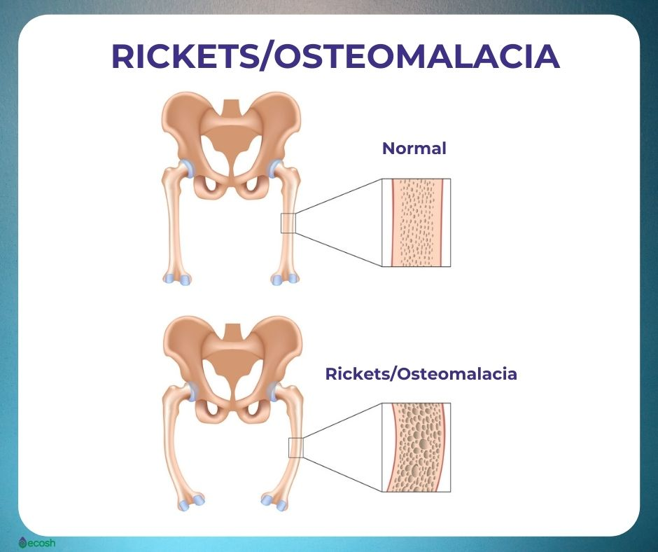
Vitamin D: Deficiency
Notes:
Rickets: a condition caused by vitamin D deficiency.

Slide 13
At Risk
Those whose are affected by deficiency of vitamin D include;
  Older adults and children who do not spend much time indoors – due to reduced exposure to the sun, the body may not make sufficient vitamin D.
  People with darker skin – darker skin reduces the ability to absorb Ultraviolet radiation B rays from the sun, essentially reducing the amount of vitamin produced.
  People with chronic health conditions – some of which affect absorption of fats into to the body.
  Obese people – their body fats binds some vitamin D and prevent it from getting into the blood stream.
  People living far from the equator where winters have short days – due to lack of sufficient exposure to the sun.
  Breastfeeding children are also at risk because human milk is a poor source of vitamin D. It is recommended that infants be given supplements of 400 IU of vitamin each day.
Notes:
Those whose are affected by deficiency of vitamin D include; Older adults and children who do not spend much time indoors. People with darker skin
People with chronic health conditions, Obese people and, People living far from the equator where winters have short days.

Slide 14
Summary
Vitamin D is sometimes called the sunshine vitamin. This is because your skin can produce all the vitamin D you need, given enough sunlight.
Nevertheless, most people don’t get enough vitamin D from sunlight alone. Also, few foods naturally contain high amounts of vitamin D, making supplements necessary.
The richest natural sources of vitamin D include fatty fish, fish oil, and mushrooms that have been exposed to sunlight or ultraviolet light.
Vitamin D deficiency is traditionally associated with osteomalacia in adults, or rickets in children. Both diseases are characterized by brittle or soft bones.
Although supplements can be taken for vitamins and other minerals, it is best to obtain any of them through natural means whenever possible.

Slide 15
References
Aslam, M. F., Majeed, S., Aslam, S., & Irfan, J. A. (2017). Vitamins: Key role players in boosting up immune response—A mini review. Vitam Miner, 6(1), 2376-1318.
DeLuca, H. (Ed.). (2012). The fat-soluble vitamins (Vol. 2). Springer Science & Business Media.
Norman, A. (2012). Vitamin D. Elsevier.

